Slide 1
DefQed: A generic, self-improving automatic statement prover based on category theory
Zijian Wang
K2106 (Class 6, Grade 2)
Northeast Yucai School (Scientific Department)
Shenyang, Liaoning, China
Email: felix_wzj@yahoo.com
ORCID: 0000-0001-8770-1755
GitHub: ZijianFelixWang

Slide 2
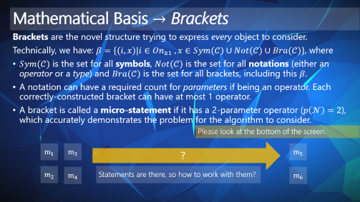
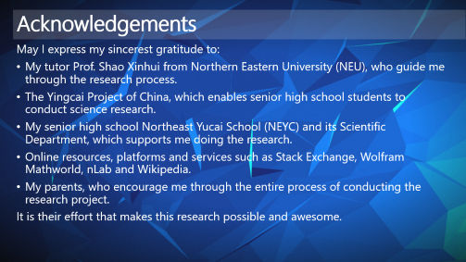
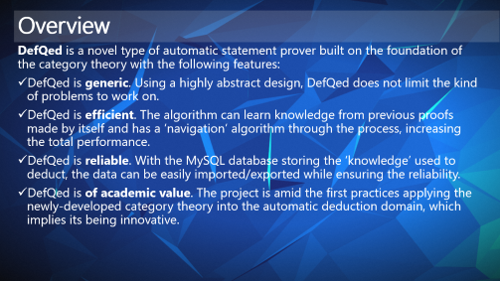
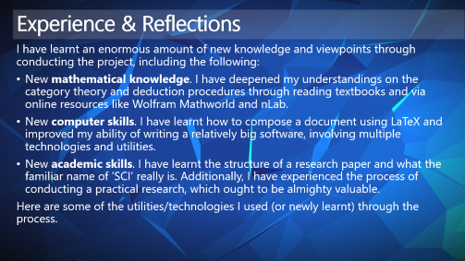
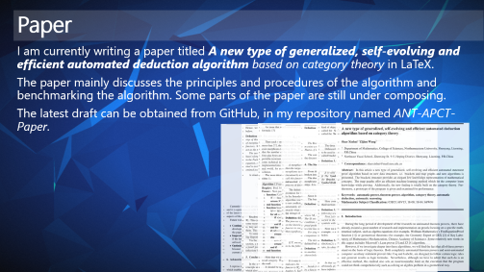
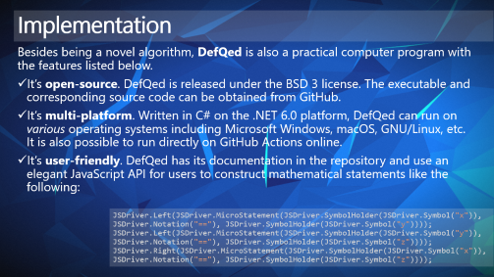
Contents

Slide 3
Overview
DefQed is a novel type of automatic statement prover built on the foundation of the category theory with the following features:
DefQed is generic. Using a highly abstract design, DefQed does not limit the kind of problems to work on.
DefQed is efficient. The algorithm can learn knowledge from previous proofs made by itself and has a ‘navigation’ algorithm through the process, increasing the total performance.
DefQed is reliable. With the MySQL database storing the ‘knowledge’ used to deduct, the data can be easily imported/exported while ensuring the reliability.
DefQed is of academic value. The project is amid the first practices applying the newly-developed category theory into the automatic deduction domain, which implies its being innovative.

Slide 4




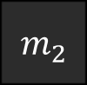


Mathematical Basis $→$ Brackets
Brackets are the novel structure trying to express every object to consider.
Technically, we have: $β=\{(i, x)|i∈On_{≥1} , x∈Sym(𝒞)∪Not(𝒞)∪Bra(𝒞)\}$, where
$Sym(𝒞)$ is the set for all symbols, $Not(𝒞)$ is the set for all notations (either an operator or a type) and $Bra(𝒞)$ is the set for all brackets, including this $β$.
A notation can have a required count for parameters if being an operator. Each correctly-constructed bracket can have at most 1 operator.
A bracket is called a micro-statement if it has a 2-parameter operator ($p\left(𝒩\right)=2$), which accurately demonstrates the problem for the algorithm to consider.
Please look at the bottom of the screen.
$$m_{1}$$
$$m_{3}$$
?
$$m_{5}$$
$$m_{2}$$
$$m_{4}$$
Statements are there, so how to work with them?
$$m_{6}$$

Slide 5




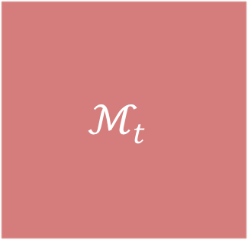





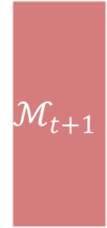




Mathematical Basis $→$ Deduction
Seeing the workspace $ℳ_{t}$ as a category containing micro-statements, we define the recurse functor $ℱ_{t}$ satisfying $ℳ_{t+1}=ℱ_{t}ℳ_{t}$, forming a series of workspaces at different steps called the deduction history.
Morphisms are used to convey the deduction relationships between the statements.
Briefly, the $ℱ_{t}$ functor utilizes a new mapping (navigation) algorithm to choose a certain $𝒦$ from a set called the knowledge base, where each $𝒦$ acts as a ‘reflection’ rule modifying the workspace and generating $ℳ_{t+1}$.
$$𝒦_{1}$$
$$𝒦_{3}$$
$$𝒦_{5}$$
$$𝒦_{n}$$
$$𝒦_{2}$$
$$𝒦_{4}$$
$$…$$
$$ℳ_{t}$$
$$ℳ_{t+1}$$
$$ℳ_{n}$$
$$m_{1}$$
$$m_{3}$$
$$m_{5}$$
…
$$⊇$$
$$m_{2}$$
$$m_{4}$$
$$m_{6}$$
$$ℱ_{t}$$

Slide 6








Mathematical Basis $→$ Self-Improvement
Another issue is how to ensure the efficiency of the algorithm when existing a great quantity of reflections.
The solution to this problem is the mapping algorithm, which decides which $𝒦$ for a $ℱ$ to choose facing a certain situation.
The initial situation is called the initial map, while each time of finishing a proof, the algorithm adds a new route to the map, shown in the animation below.
$$𝒦_{4}$$
Initial Map
$$𝒦_{3}$$
$$𝒦_{5}$$
$$m_{1}$$
$$m_{3}$$
$$𝒦_{2}$$
$$m_{5}$$
$$m_{2}$$
$$…$$
$$m_{4}$$
$$m_{6}$$
$$𝒦_{1}$$
$$𝒦_{n}$$

Slide 7
Implementation
Besides being a novel algorithm, DefQed is also a practical computer program with the features listed below.
It’s open-source. DefQed is released under the BSD 3 license. The executable and corresponding source code can be obtained from GitHub.
It’s multi-platform. Written in C# on the .NET 6.0 platform, DefQed can run on various operating systems including Microsoft Windows, macOS, GNU/Linux, etc. It is also possible to run directly on GitHub Actions online.
It’s user-friendly. DefQed has its documentation in the repository and use an elegant JavaScript API for users to construct mathematical statements like the following:
JSDriver.Left(JSDriver.MicroStatement(JSDriver.SymbolHolder(JSDriver.Symbol("x")), JSDriver.Notation("=="), JSDriver.SymbolHolder(JSDriver.Symbol("y"))));
JSDriver.Left(JSDriver.MicroStatement(JSDriver.SymbolHolder(JSDriver.Symbol("y")), JSDriver.Notation("=="), JSDriver.SymbolHolder(JSDriver.Symbol("z")))); JSDriver.Right(JSDriver.MicroStatement(JSDriver.SymbolHolder(JSDriver.Symbol("x")), JSDriver.Notation("=="), JSDriver.SymbolHolder(JSDriver.Symbol("z"))));

Slide 8
Implementation
The table below shows the development of the program. The current version is v0.03 and a few of functionalities are still under active development and enhancement.
Item | V0.01 | V0.02 | V0.03 (Current) | vNext
Basic Deduction Kernel | ✔️ | ✔️ | ✔️ | ✔️
MySQL Driver | ✔️ | ✔️ | ✔️ | ✔️
XML Driver | ✔️ | ✔️ | ✔️ | ✔️
JS Driver & API | ❌ | ✔️ | ✔️ | ✔️
Self-Improvement Algorithm | ❌ | ❌ | ✔️ | ✔️
Infinite Set Support | ❌ | ❌ | ❌ | ✔️
Friendlier Proof Steps Output | ❌ | ❌ | ✔️ | ✔️
NetQed Workflow | ❌ | ✔️ | ✔️ | ✔️

Slide 9
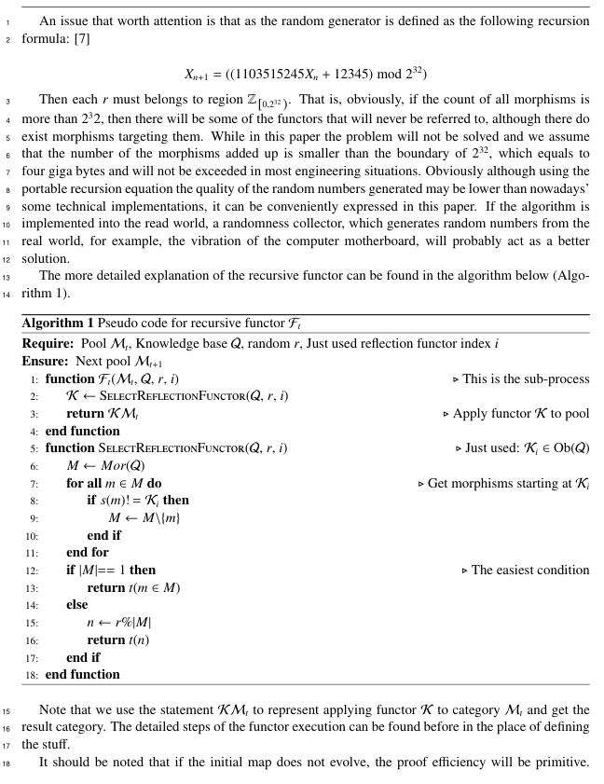
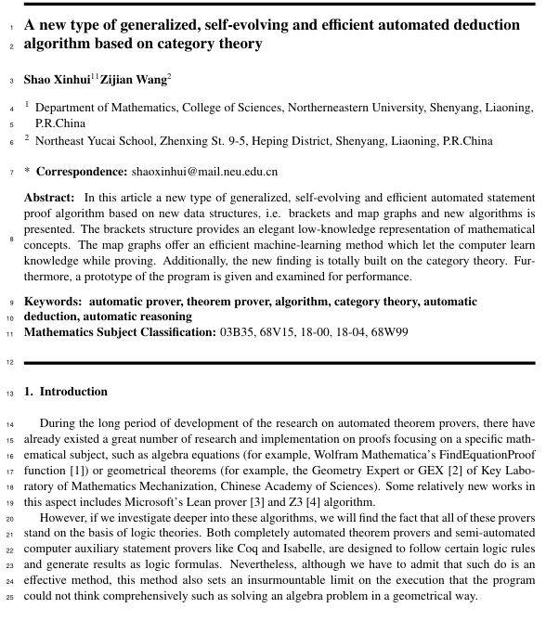
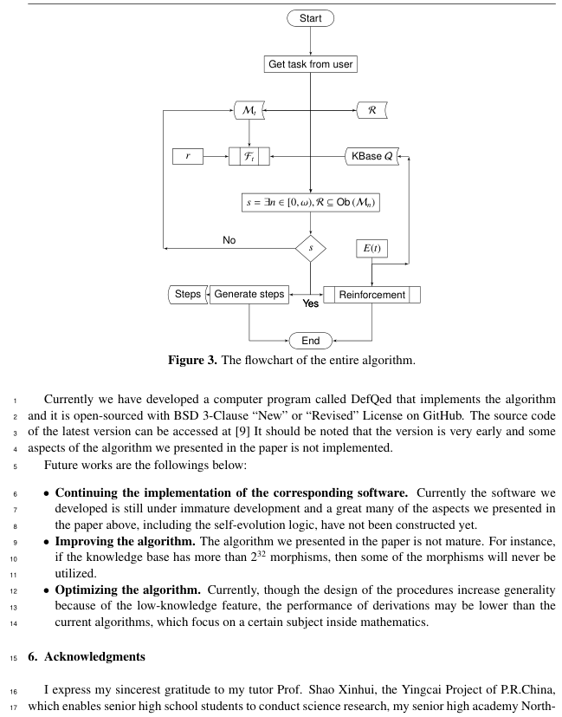
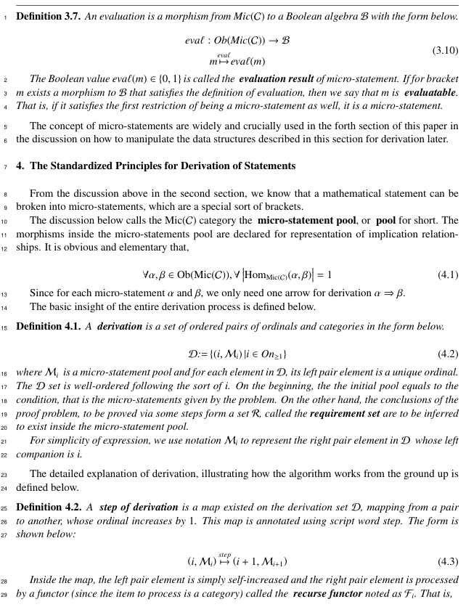
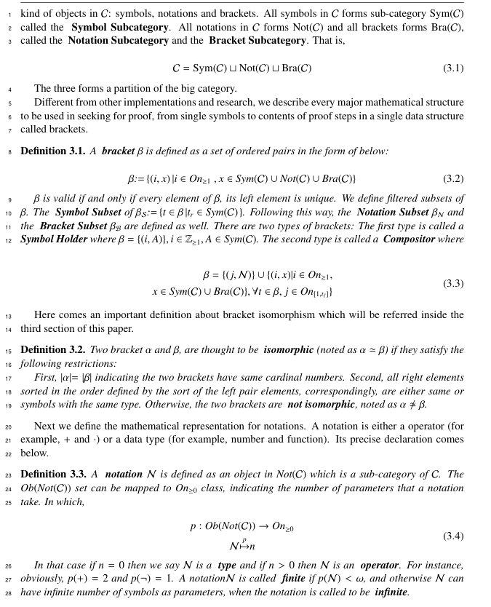
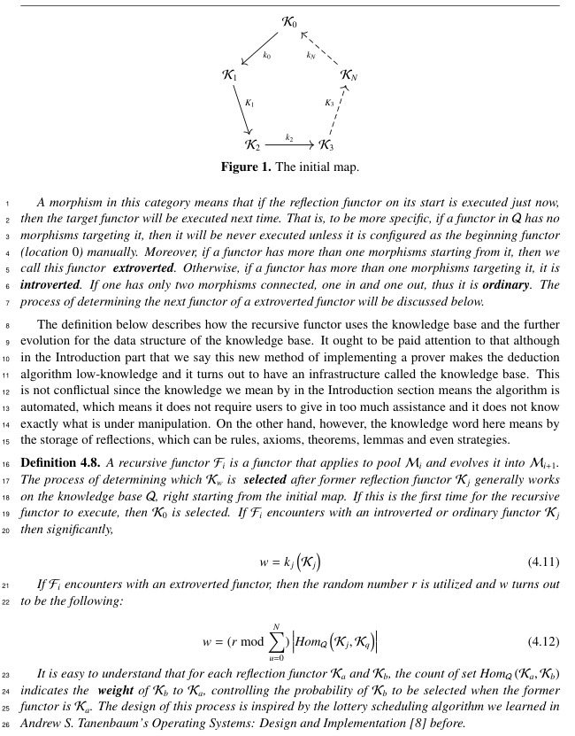
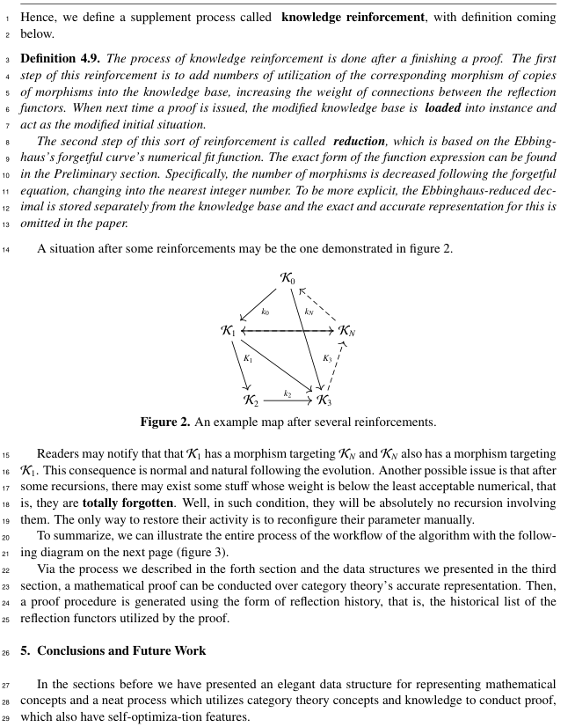
Paper
I am currently writing a paper titled A new type of generalized, self-evolving and efficient automated deduction algorithm based on category theory in LaTeX.
The paper mainly discusses the principles and procedures of the algorithm and benchmarking the algorithm. Some parts of the paper are still under composing.
The latest draft can be obtained from GitHub, in my repository named ANT-APCT-Paper.

Slide 10


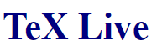







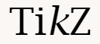





Experience & Reflections
I have learnt an enormous amount of new knowledge and viewpoints through conducting the project, including the following:
New mathematical knowledge. I have deepened my understandings on the category theory and deduction procedures through reading textbooks and via online resources like Wolfram Mathworld and nLab.
New computer skills. I have learnt how to compose a document using LaTeX and improved my ability of writing a relatively big software, involving multiple technologies and utilities.
New academic skills. I have learnt the structure of a research paper and what the familiar name of ‘SCI’ really is. Additionally, I have experienced the process of conducting a practical research, which ought to be almighty valuable.
Here are some of the utilities/technologies I used (or newly learnt) through the process.

Slide 11
Acknowledgements
May I express my sincerest gratitude to:
My tutor Prof. Shao Xinhui from Northern Eastern University (NEU), who guide me through the research process.
The Yingcai Project of China, which enables senior high school students to conduct science research.
My senior high school Northeast Yucai School (NEYC) and its Scientific Department, which supports me doing the research.
Online resources, platforms and services such as Stack Exchange, Wolfram Mathworld, nLab and Wikipedia.
My parents, who encourage me through the entire process of conducting the research project.
It is their effort that makes this research possible and awesome.

Slide 12
Thank you for your attention.
© Zijian Wang, 2022.
You can get a copy of this slideshow from GitHub.

